Slide 1
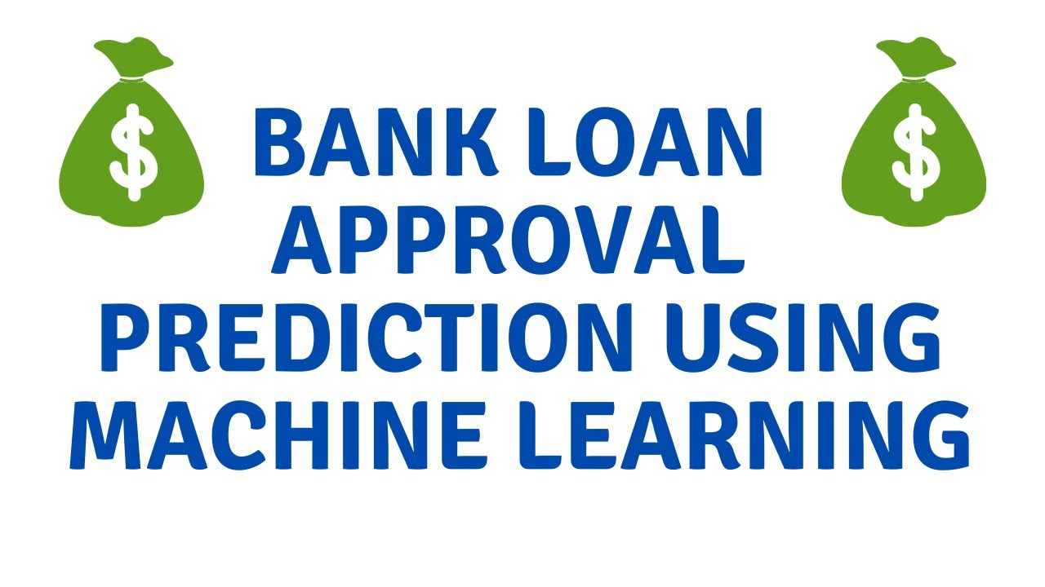

Bhargava Gaggainpali
DSC680 - Applied Data Science
bgaggainpali/bgaggainpali_DSC680 · GitHub

Slide 2
Business problem & Hypothesis
In financial industry, decision on a loan application, whether to approve or not is a two-edged sword. Bank should not lose business by denying a legitimate customer, who can repay. Also, it should not approve loan to in-eligible customer. Banks are playing important role in challenging times like now, with COVID pandemic across the globe.
I have selected the topic, as I was interested in knowing the process of loan approval and the key factors in it. As I explore more about the domain, I understand that it’s not same set of rules which is being followed across domain. And each subdomain like Home loan approval, Car loan approval and such classification have basic approval structure, but the factors which influence are different.

Slide 3
Solution Method
I see this problem as a classification issue, where we should try to understand and able to predict the customers, who have high Loan approval eligibility. Supervised machine learning algorithm to work on the classification problem to be trained with algorithms like:
1. Logistic Regression
2. Decision Tree
3. Random Forest
Perform Exploratory Data Analysis (EDA) on the data by doing Univariate and Bivariate Analysis, to identify missing values and outliers and fill the gaps with appropriate values.
Building model with different models to find and observe the accuracy of the model. If the accuracy of the of the model is not high, then use the Ensample methods for higher accuracy.

Slide 4
Data
Data is sourced from Kaggle, which has all the required variables for prediction.
https://www.kaggle.com/premptk/loan-approval-prediction-model/data?select=LoanApprovalPrediction.csv
Variable Description
Loan_ID Unique Loan ID
Gender Male/ Female
Married Applicant married (Y/N)
Dependents Number of dependents
Education Applicant Education (Graduate/ Under Graduate)
Self_Employed Self employed (Y/N)
ApplicantIncome Applicant income
CoapplicantIncome Coapplicant income
LoanAmount Loan amount in thousands
Loan_Amount_Term Term of loan in months
Credit_History credit history meets guidelines
Property_Area Urban/ Semi Urban/ Rural
Loan_Status Loan approved (Y/N)

Slide 5
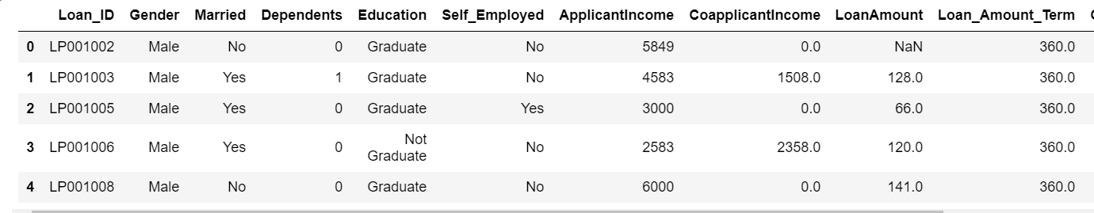
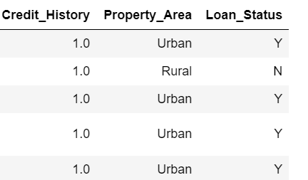
Exploring Data 1

Slide 6
Exploring Data 2
Categorical Features: Based on the data, (Yes/No or Male/Female) below are categorical variables.
Gender
Married
Self_Employed
Credit_History
Loan_Status
Ordinal Features: Based on the data with inherent hierarchy, below are ordinal variables.
Dependents
Education
Property_Area
Numerical Features: Based on the numerical data, below are numerical variables.
ApplicantIncome
Co-applicantIncome
LoanAmount
Loan_Amount_Term

Slide 7
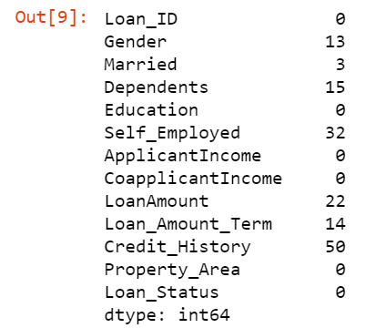
Exploring Data 3
Missing Values in Data: We observed that 50 missing values in Credit_History and 32 missing values in Self_Employed variable.

Slide 8
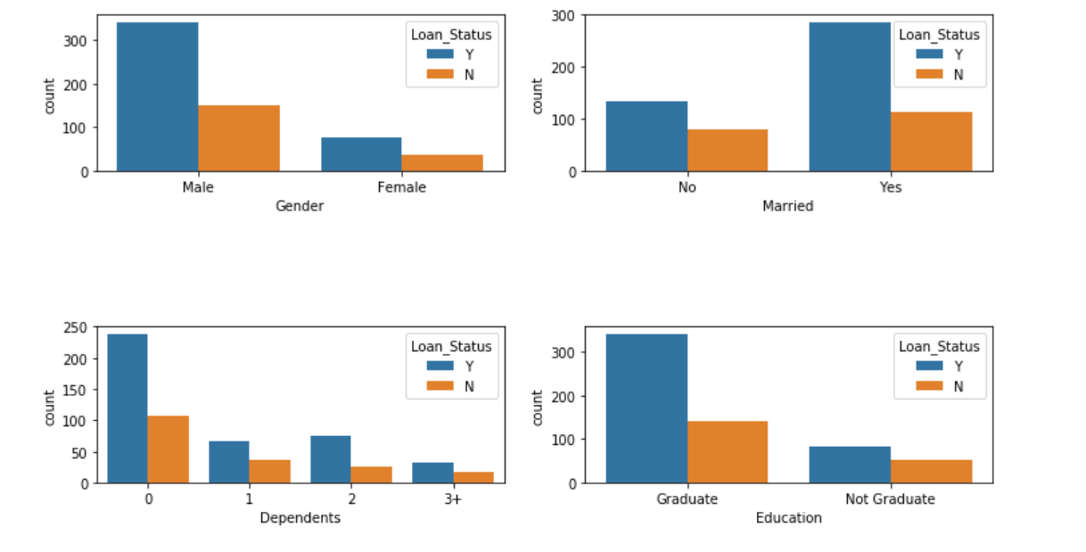
Categorical Plots 1

Slide 9
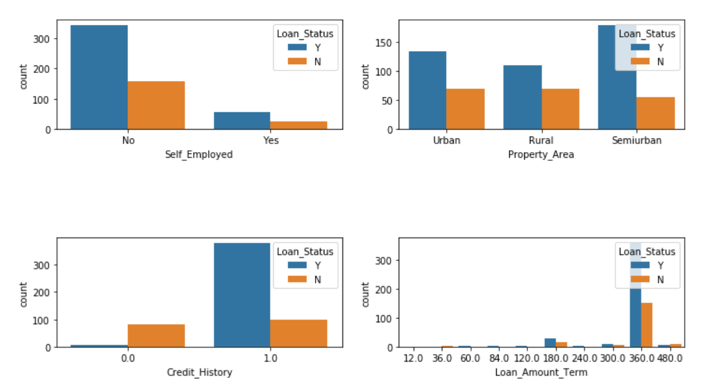
Categorical Plots 2

Slide 10
Observations
Gender: There are around 300 Men and 100+ Women in the dataset.
Marital Status: Around 65% of the population in the dataset is Marred. Also, married applicants are more likely to be granted loans.
Dependents: Most of the loan applicants have zero dependents and are also likely to accepted for loan.
Education: About 80% of the population is Graduate and graduates have higher probability of loan approval
Employment: 80% of population are not self employed.
Property Area: Majority applicants are from Semi-urban and also likely to be granted loans.
Credit_History: Applicants with credit history are far more likely to be accepted.
Loan Amount Term: Majority of the loans taken are for 360 Months (30 years).

Slide 11
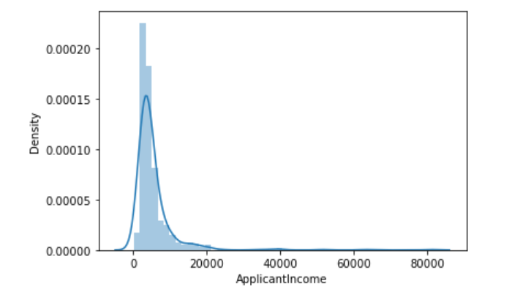
Distribution of Annual Income
Income distribution is right-skewed, most of the applicant's annual income is below $20000.

Slide 12
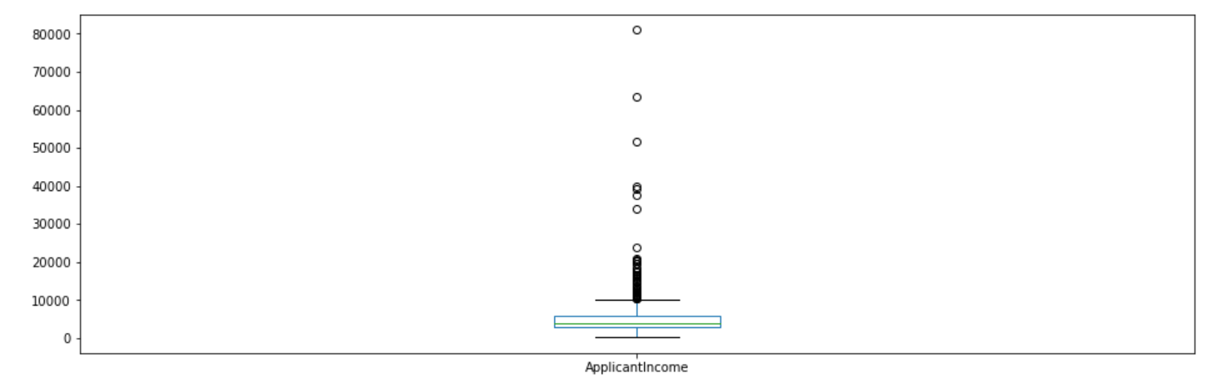
Outlier Detection
From the above boxplot, it’s clear that there are outliers in the data, it is due to income disparity in the society.

Slide 13
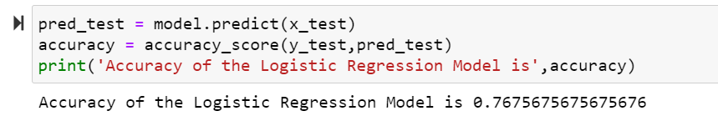
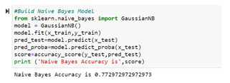
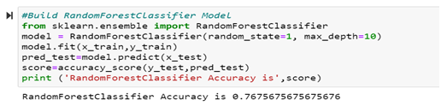
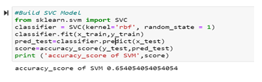
Predictive Models
Four models build are built using Logistic Regression, Random forest, Naïve Bayes & SVM.

Slide 14
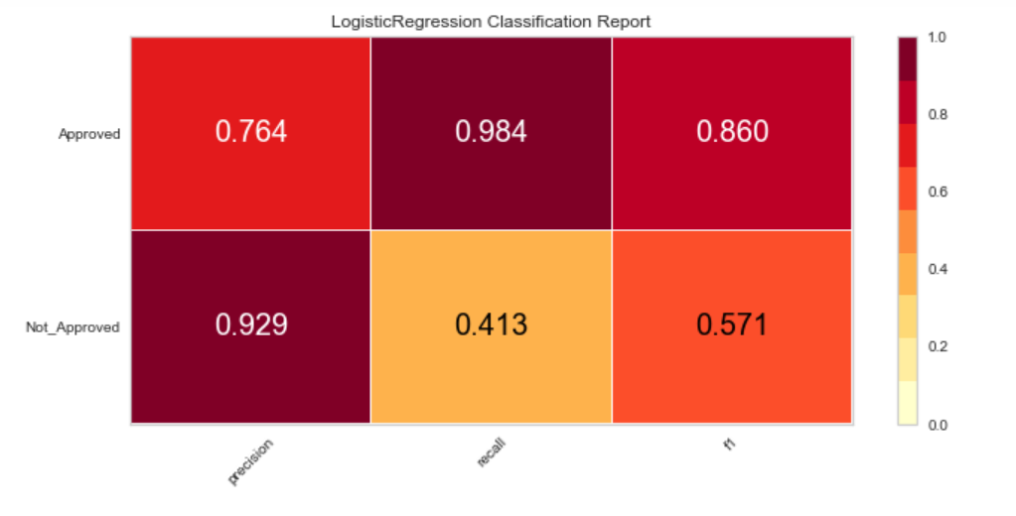
Classification Report
Chart shows the good precision and recall values and f1score 0.860 for approved cases indicates that model is performing as expected.

Slide 15
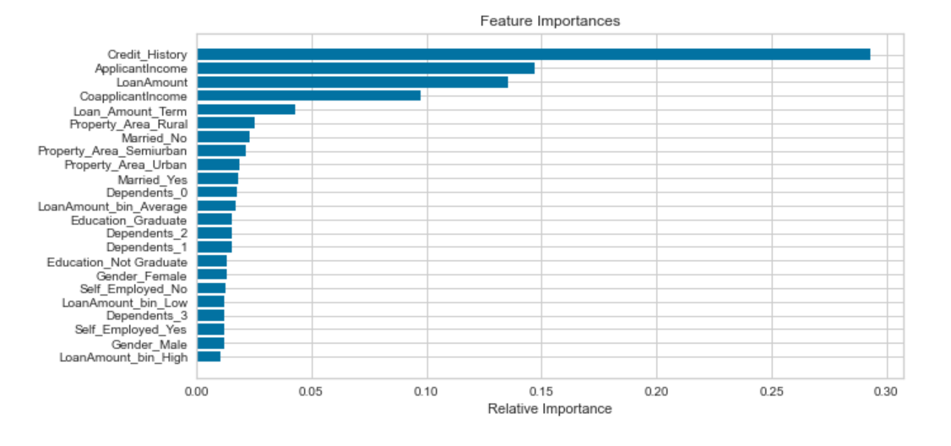
Feature Importance
Above chart shows that credit history is most important factor in deciding the loan application followed by applicant income and loan amount.

Slide 16
Future Analysis Questions
I would like to continue my analysis and try to explore further to find answers to the given questions.
With the COVID situation in place, are these features still valid to predict the Loan approval process.
As with the different type of Loans like Home Loan vs Car Loan, would these features stay in common across industry.
Will the feature importance change with respect to geographic location?

Slide 17
Reference
Kumar Arun, Garg Ishan, Kaur Sanmeet – 2016 - IOSR Journal of Computer Engineering (IOSR-JCE) - Loan Approval Prediction based on Machine Learning Approach. 4. 18-21.pdf (iosrjournals.org)
Mohammad Ahmad Sheikh; Amit Kumar Goel; Tapas Kumar - 2020 – IEEE - An Approach for Prediction of Loan Approval using Machine Learning Algorithm | IEEE Conference Publication | IEEE Xplore
Rajiv Kumar, Vinod Jain, Prem Sagar Sharma, Shashank Awasthi, Gopal Jha – 2019 - Prediction of Loan Approval using Machine Learning | International Journal of Advanced Science and Technology (sersc.org)
Rahul Shukla - Sep 19, 2020 - Prediction of Loan Approval with Machine Learning https://medium.com/@rahulshuklawork/prediction-of-loan-approval-with-machine-learning-539cbd2aad31
Mridul Bhandari - Sep 14, 2020 - How to predict Loan Eligibility using Machine Learning Models Build predictive models to automate the process of targeting the right applicants.https://towardsdatascience.com/predict-loan-eligibility-using-machine-learning-models-7a14ef904057

